Slide 1


The Autonomic
Nervous System

Slide 2
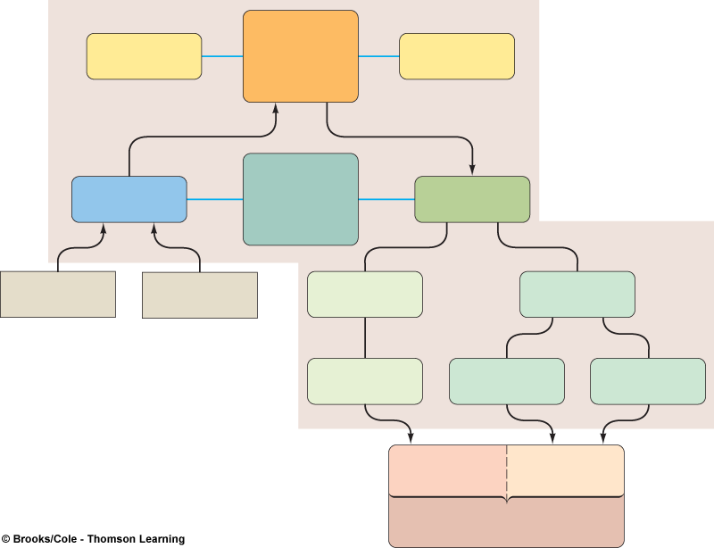
Central
nervous
system
(CNS)
Brain
Spinal
cord
(Input to CNS
from periphery)
(Output from CNS
to periphery)
Peripheral
nervous
system
(PNS)
Afferent
division
Efferent
division
Sensory
stimuli
Visceral
stimuli
Somatic
nervous system
Autonomic
nervous system
Motor
neurons
Sympathetic
nervous system
Parasympathetic
nervous system
Skeletal
muscle
Smooth muscle
Cardiac muscle
Glands
Effector organs
(made up of muscle
and gland tissue)

Slide 3
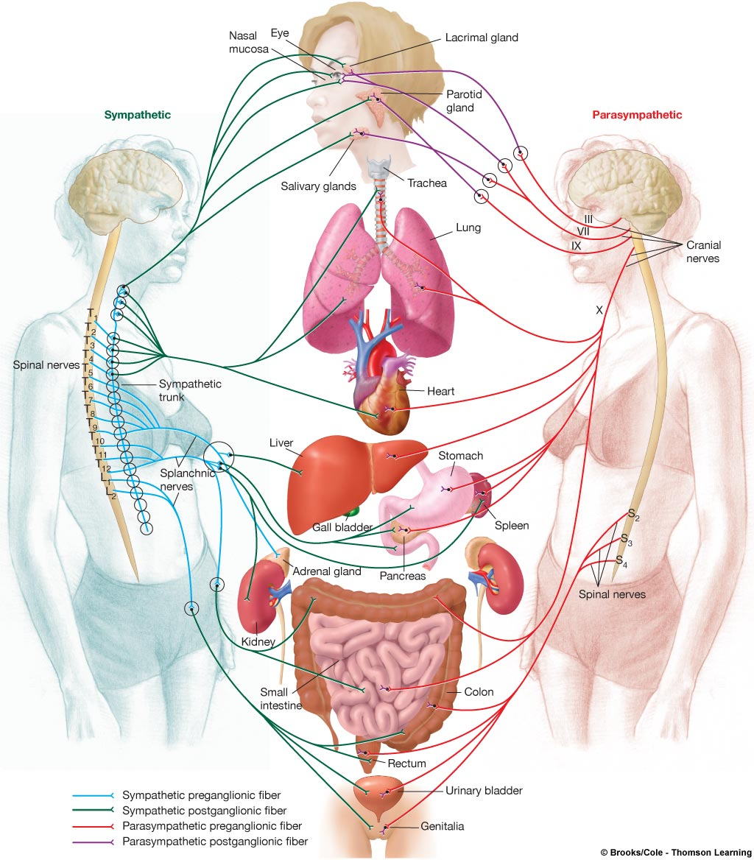
Autonomic Nervous System Overview
Many sensory neurons are interoceptors
Eg. chemoreceptors and mechanoreceptors
Motor neurons regulate visceral activities
Parasympathetic vs Sympathetic divisions

Slide 4
General Anatomy of the Autonomic Nervous System
The ANS controls the involuntary responses of visceral organs and maintains homeostasis.
The visceral organs receive dual innervation. They are signaled by both subdivisions of the ANS.
Usually both subdivisions are active in controlling the activity of an internal organ. This ongoing activity is called sympathetic or parasympathetic tone activity.

Slide 5

Autonomic Nervous System – Sympathetic Division Physiology
Fight or Flight response:
pupils of the eye dilate
sweating is promoted – galvanic skin response
heart rate increase
bronchioles dilate
motility for digestion is inhibited
liver: conversion of glycogen into glucose
urination is inhibited

Slide 6

Autonomic Nervous System – Parasympathetic Division Physiology
Dominant during rest
Promotes:
Digestion
Decrease in heart rate
Decrease in bronchiole size
Other maintenance activities:
Defecation
Micturition

Slide 7
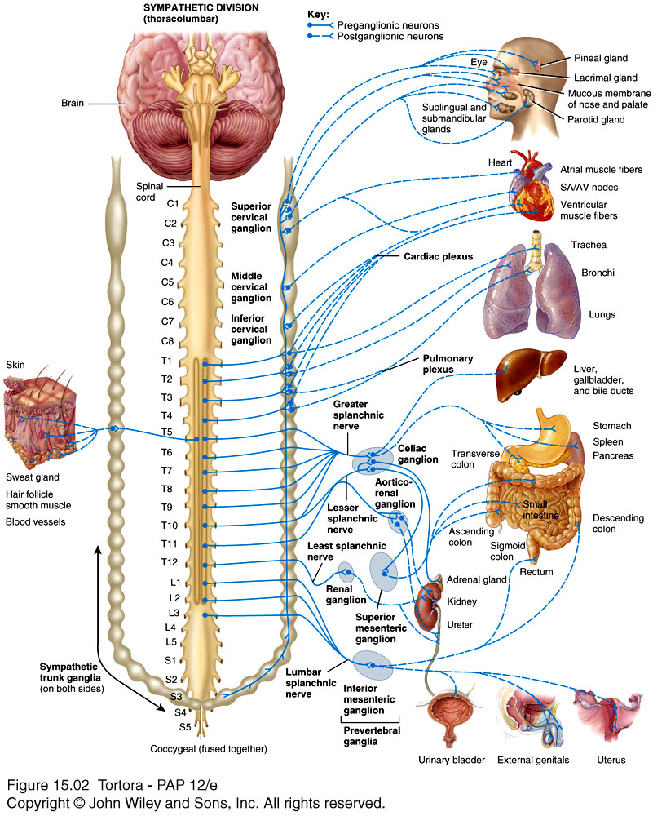
General Anatomy of the Autonomic Nervous System – Sympathetic System
Sympathetic
nerve fibers originate from thoracic and lumbar levels of the spinal cord.
preganglionic fibers are short/postganglionic fibers are long
sympathetic chain ganglia near spinal cord

Slide 8
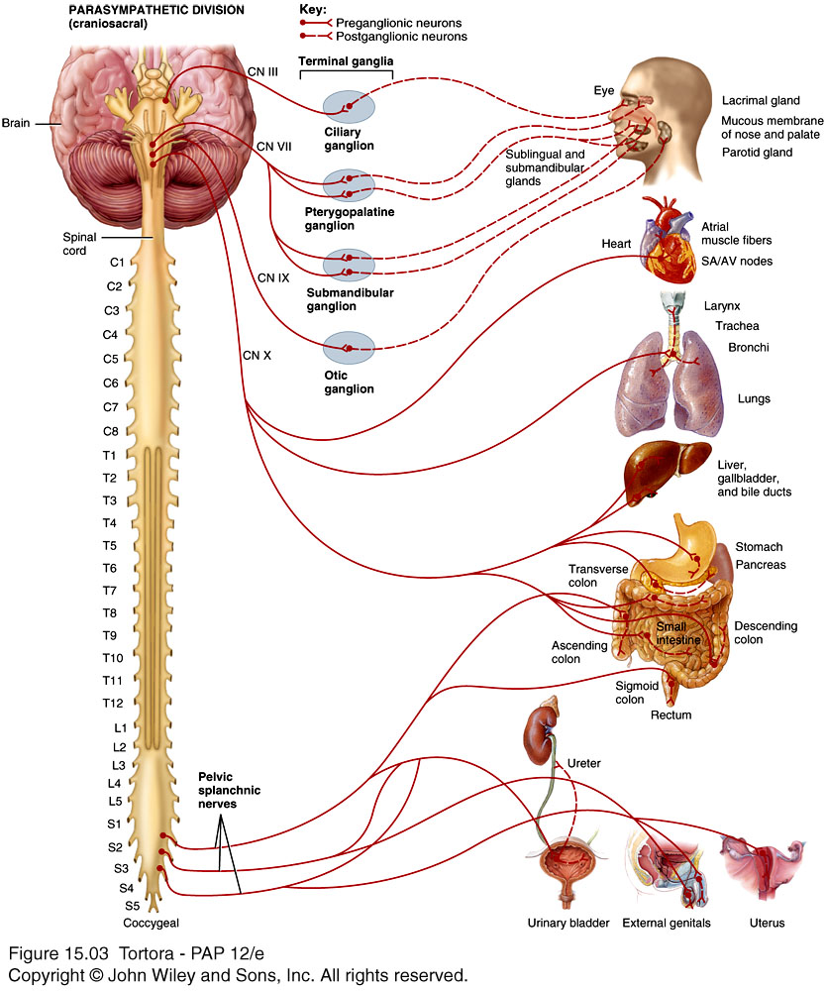
General Anatomy of the Autonomic Nervous System – Parasympathetic System
Parasympathetic
nerve fibers originate from cranial and sacral levels
preganglionic fibers are long/postganglionic fibers are short
terminal ganglia near effector organs.

Slide 9
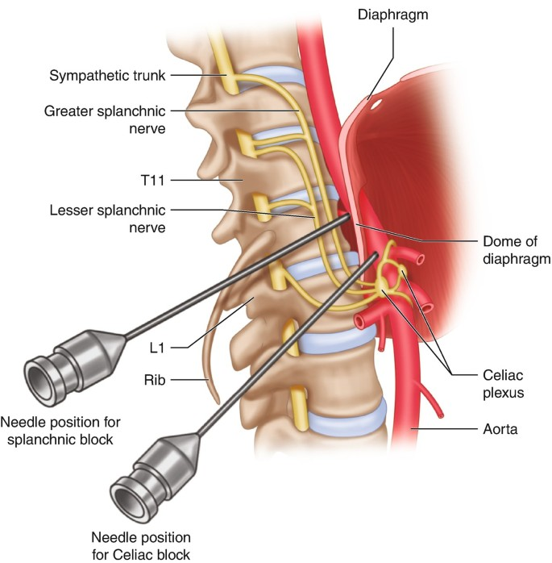
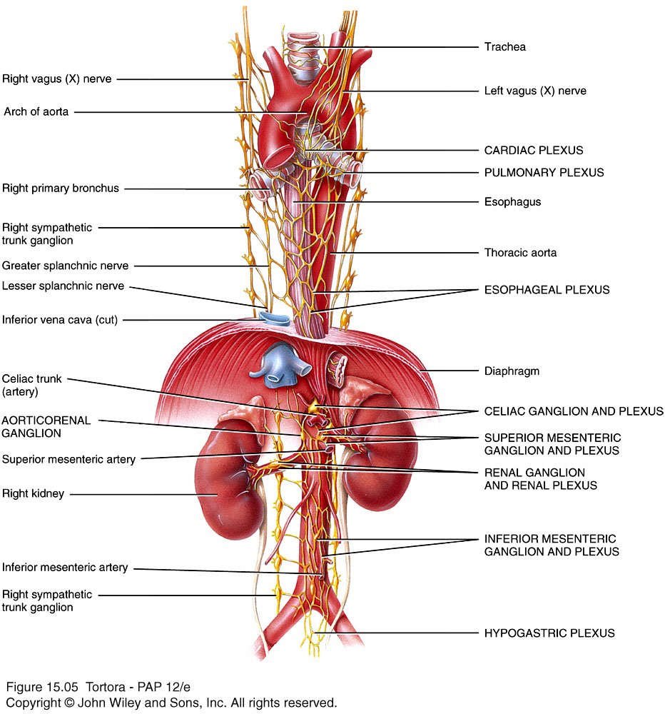
Autonomic Plexus
There are several autonomic plexuses each containing both sympathetic and parasympathetic neurons.
Celiac or Solar plexus – near the celiac trunk. This is the largest and provides innervation to multiple abdominal and pelvic organs
Notes:
Essentials of Interventional Techniques in Managing Chronic Pain pp 595–607Cite as
Celiac Plexus Blocks and Splanchnic Nerve Blocks
Vijay Babu,
Karthik Kura &
Karina Gritsenko
Chapter
First Online: 05 January 2018
2883 Accesses
1 Citations
Abstract
Nerve blocks of the celiac axis are a valuable tool for the comfort and pain relief of patients with acute and chronic pain generated from the abdominal viscera. Sources most commonly include abdominal cancers and primarily pancreatic cancer. A local anesthetic or neurolytic solution is used to temporarily or permanently block the celiac plexus nerves from transmitting pain signals from the abdomen to the brain. Understanding the anatomy, pathophysiology, and effect/side effect profile of this block is necessary for performing the block. Though performing this block has been described with and without various forms of imaging, two mainstream techniques using fluoroscopic guidance, transcrural and retrocrural, are discussed and explained in detail.

Slide 10
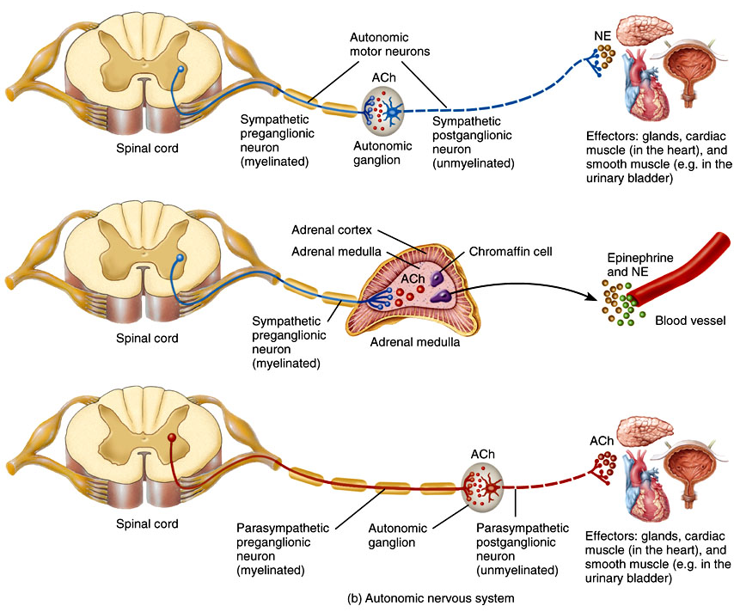
General Anatomy of the Autonomic Nervous System – Neurotransmitters
Notes:
15_01

